Slide 1

Control Systems EE 221

Slide 2
Control Engineer
Role of Control Engineer
Electrical Engineering
Communication Engineering
Mechanical Engineering
Civil Engineering
Industrial Engineering
Aerospace Engineering

Slide 3
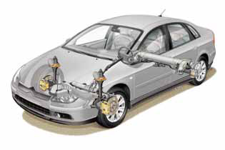
CONTROL SYSTEMS MODELING
UNIT I
Control
Engineering

Slide 4
CONTENTS
Introduction
Types of control systems-
Open Loop & Closed Loop
Feed back control system, Effect of feedback
Modelling of Simple electrical & Mechanical Systems using differential Equations
Concept of T.F., Characteristic equation, Poles & Zeros
Block Diagram Reduction
Signal flow graph

Slide 5
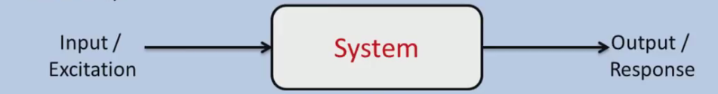
System
When number of elements or components are connected in a sequence to perform a specific function, the group thus formed is called a system
SYSTEM
R (t)
C (t)

Slide 6
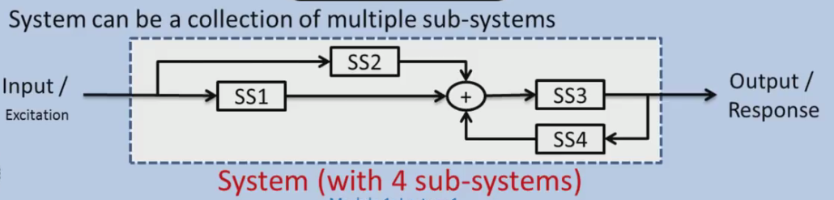
Subsytem

Slide 7
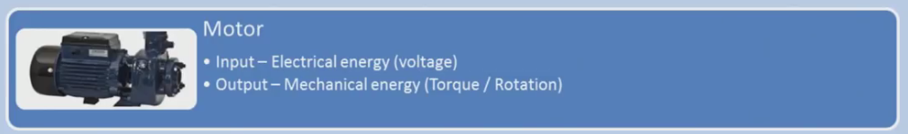
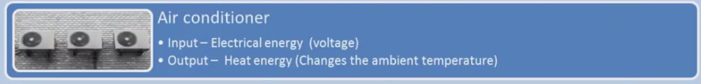


Examples of system

Slide 8
Example of air conditioner
Switch – AC
Switch – timer
Switch- timer-sensor for temp -AC

Slide 9
Control
The word control is usually taken to mean :
- regulate,
- direct,
- command.

Slide 10
Control system
A Control System is an arrangement of physical components connected or related in such a manner as to command, direct, or regulate itself or another system.
Example: Air conditioning, elevators, tracking the enemy plane

Slide 11
Elements of Control System
Plant
Controller
Input (excitation)
Output (Response)
CONTROLLER
CONTROLLER
PLANT
Generalized Block Diagram

Slide 12
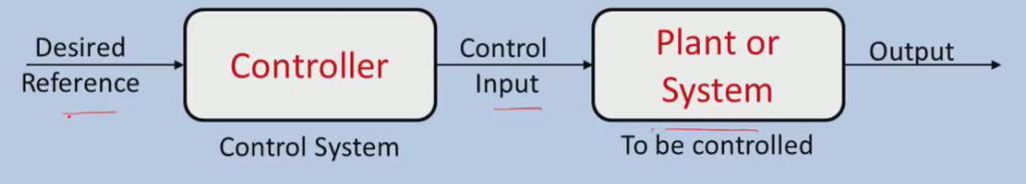
Complete System

Slide 13
Need of control system.
Power Amplification
Remote Control
Convenience

Slide 14
Control system Configurations.
Open Loop
Closed Loop

Slide 15
Design Objectives
Before designing sensors, actuators or control architectures, it is important to know the goal, that is, to formulate the control objectives. This includes
what does one want to achieve (energy reduction, yield increase,...)
what level of performance is necessary (accuracy, speed,...)
Notes:
<<<1.5.2>>>

Slide 16
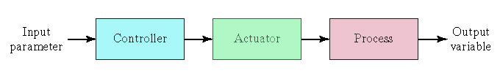
Open Loop & Closed Loop
OPEN LOOP SYSTEM
An open-loop controller, also called a non-feedback controller
The system does not observe the output of the processes that it is controlling.
Cannot correct any errors
may not compensate for disturbances in the system.
Open Loop System

Slide 17
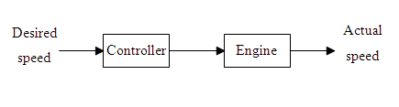
EXAMPLE: Automobile speed control
Open loop System

Slide 18
Example 1: Driving system of automobile
Parameter: Speed
Maintained by controlling pressure on accelerometer
Automobile Driving System: Accelerometer, Carburetor, engine-Vehicle.
Rate of Fuel Flow
Output (controlled) variable
Input(command) signal
Accelerator pedal, Linkages and carburetor
Engine- Vehicle
Force
Speed

Slide 19
Example Cont…
Flow of traffic
Sprinkling Water to Lawns
Electric Switch
Automatic Washing Machine
Automatic toaster system
Electric Hand- Drier

Slide 20
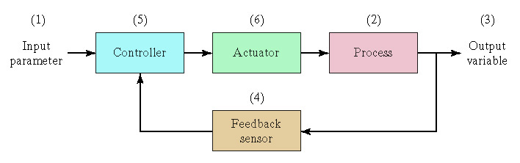
Closed Loop system
Close loop control systems use the open loop systems (as forward path) and feedback from the output to decide the input level to the open loop system.
The non idealities in forward path do not degrade the system performance.
The accuracy of the output thus depends on the feedback path

Slide 21
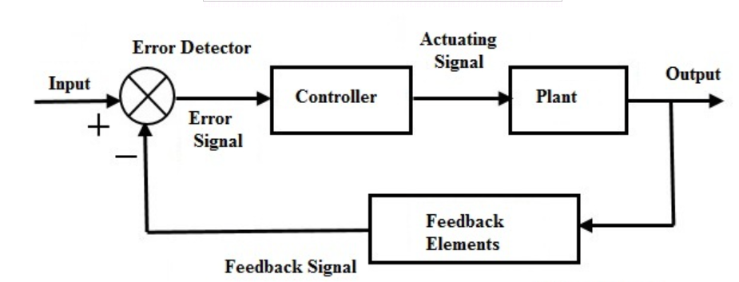

Slide 22
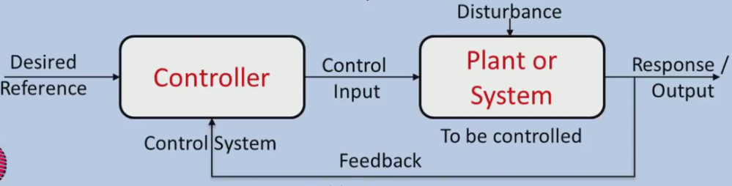

Slide 23
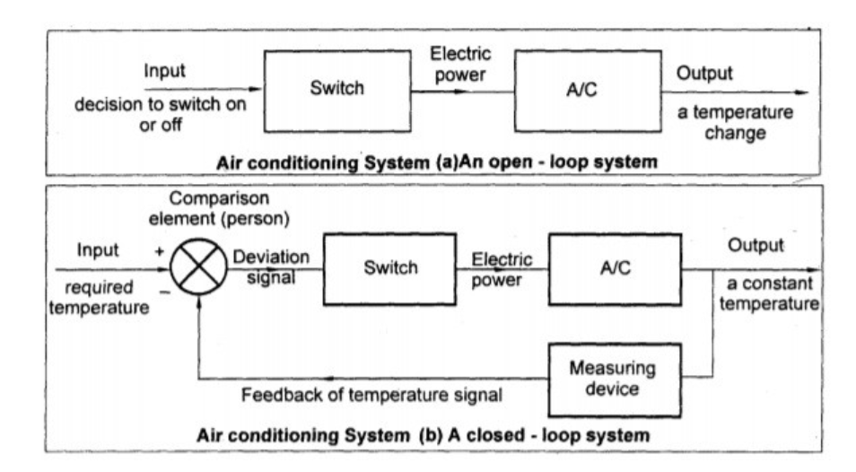

Slide 24
The order of events in a closed-loop control
Measurement of the controlled variable
Calculation of the control error (comparison of the controlled variable with the set-point value )
Processing of the control error such that by changing the manipulated variable the control error is reduced or removed

Slide 25
Feedback and its effect
Reduces error between reference input and system output.
Reduction in error improves system performance like stability, overall gain, sensitivity.
Feedback exists when cause- effect / input output relationship exists among variables of system.

Slide 26
Feedback
Feedback is a key tool that can be used to modify the behavior of a system.
This behavior altering effect of feedback is a key mechanism that control engineers exploit deliberately to achieve the objective of acting on a system to ensure that the desired performance specifications are achieved

Slide 27
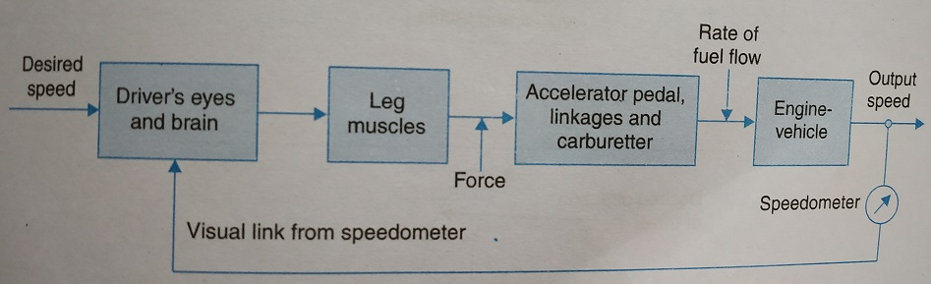
Manually controlled closed Loop system

Slide 28
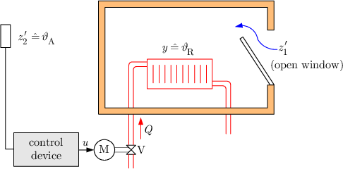
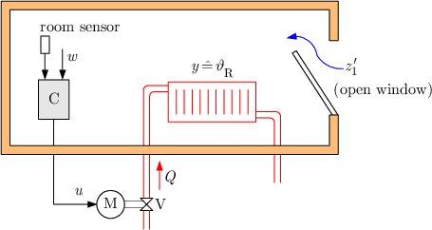
EXAMPLE: Room Heating
Open loop control system
Closed loop control system

Slide 29
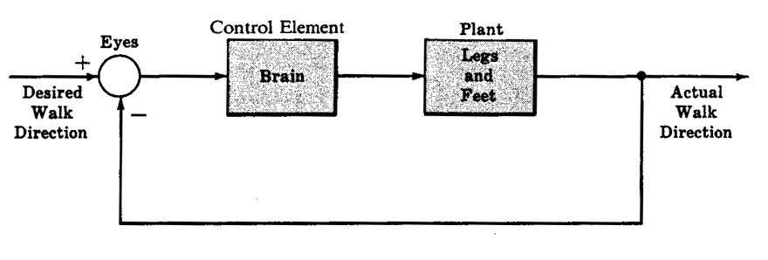
Problem
Design Problem
Draw a block diagram for how your eyes and brain help regulate the direction in which you are walking:

Slide 30
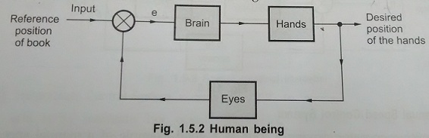
Human Being

Slide 31
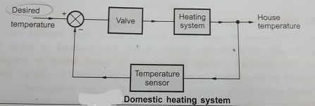
Domestic Heating System

Slide 32
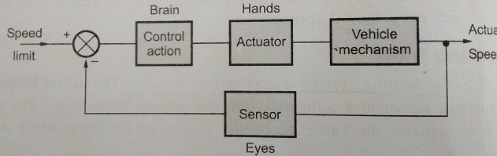
Manual speed Control of MOTOR

Slide 33
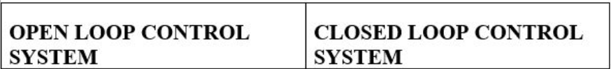
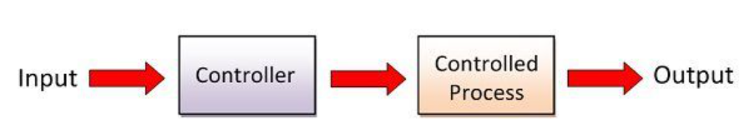
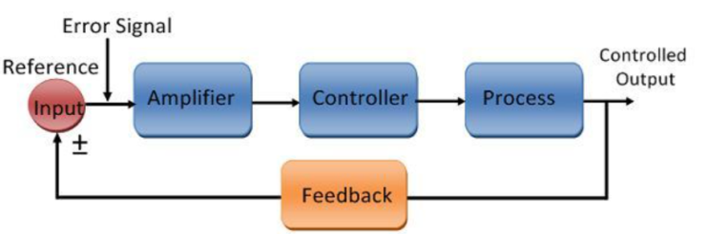
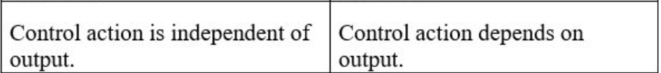
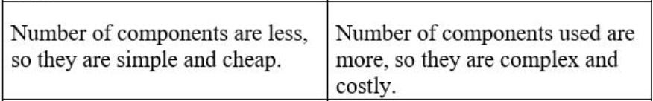
Comparison between open loop and closed loop system

Slide 34
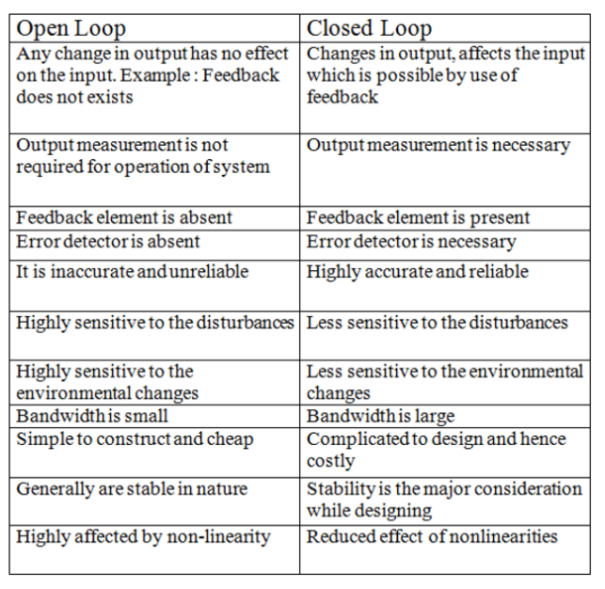
Comparison between open loop and closed loop system

Slide 35
Types of control systems
Natural Control System
Manmade Control System
Combinational Control system
Time variant & Time-Invariant systems
Linear & Non-Linear systems
Static & Dynamic Systems
Continuous time & Discrete Time

Slide 36
Linear and non linear systems
Linear systems :
Systems which obey principle of superposition and homogeniety.
Non- linear systems.
Systems which do not obey principle of superposition and homogeniety.

Slide 37
Time variant and time invariant systems.
Time invariant system :
Parameters remain stationary with respect to time during the operation of the system.
Output do not change with time.
Represented by constant coefficient of differential equation.
Time invariant system :
Parameters are not stationary with respect to time during the operation of the system.
Output changes with time.
Coefficient of differential equation are functions of time.

Slide 38
Summary so far
Distinction between open loop and closed loop
Advantages and disadvantages of each
Block diagrams for control systems
Inputs, outputs, operations
Closed loop vs. open loop block diagrams

Slide 39
Block Diagram Fundamentals

Slide 41
Mathematical Modelling of Control Systems

Slide 42
Introduction
Mathematical equations, describing the characteristics of a system is called mathematical model of the system.
There are two types of mechanical systems based on the type of motion.
Translational mechanical systems
Rotational mechanical systems

Slide 43
Mathematical modelling of
Mechanical system
a) Translatory system
b) Rotational system
2) Electrical system.

Slide 44
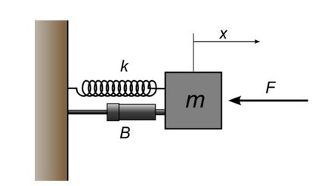
Modeling of Translational Mechanical Systems
Translational mechanical systems move along a straight line.
Three basic elements:
Mass
Spring
Dashpot or Damper.
If a force is applied to a translational mechanical system, then it is opposed by opposing forces due to mass, elasticity and friction of the system.
Since the applied force and the opposing forces are in opposite directions, the algebraic sum of the forces acting on the system is zero.

Slide 45
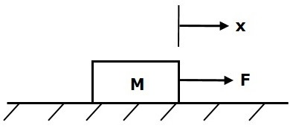
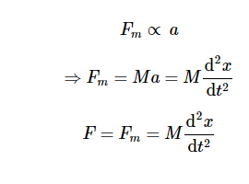
Mass
F is the applied force
F_{m} is the opposing force due to mass
M is mass
a is acceleration
x is displacement
Mass is the property of a body, which stores kinetic energy.
This opposing force is proportional to the acceleration of the body.
Assume elasticity and friction are negligible.

Slide 46
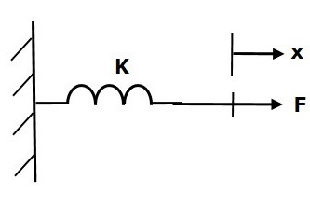
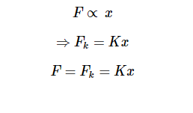
Spring
F is the applied force
F_{k} is the opposing force due to elasticity of spring
K is spring constant
x is displacement
Spring is an element, which stores potential energy.
Restoring force is introduced in the spring.
Assume mass and elasticity are negligible.

Slide 47
Dashpot
Representation of viscous friction force.
Viscous friction force : force of friction between two moving surfaces separated by viscous fluid.

Slide 48
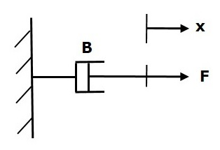
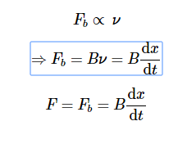
Dashpot
F_{b} is the opposing force due to friction of dashpot
B is the frictional coefficient
v is velocity
x is displacement
This opposing force is proportional to the velocity of the body.
Assume mass and elasticity are negligible.

Slide 49
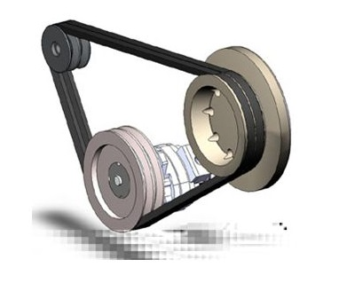
Modeling of Rotational Mechanical Systems
Rotational mechanical systems move about a fixed axis.
Three basic elements.
Moment of inertia,
Torsional spring
Dashpot.
If a torque is applied to a rotational mechanical system, then it is opposed by opposing torques due to moment of inertia, elasticity and friction of the system. Since the applied torque and the opposing torques are in opposite directions, the algebraic sum of torques acting on the system is zero.

Slide 50
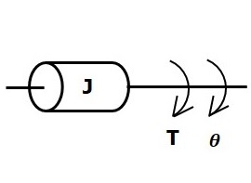
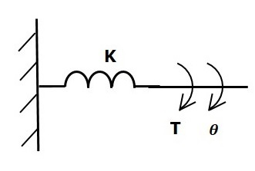
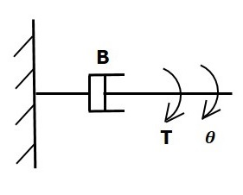
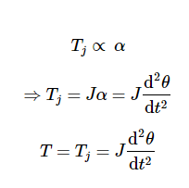
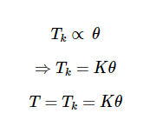
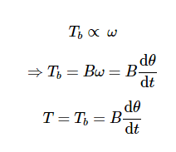
Rotational Systems
Moment of Inertia
Torsional Spring
Dashpot

Slide 51
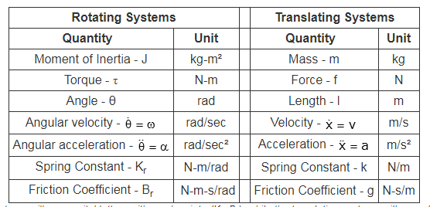
Comparison

Slide 52
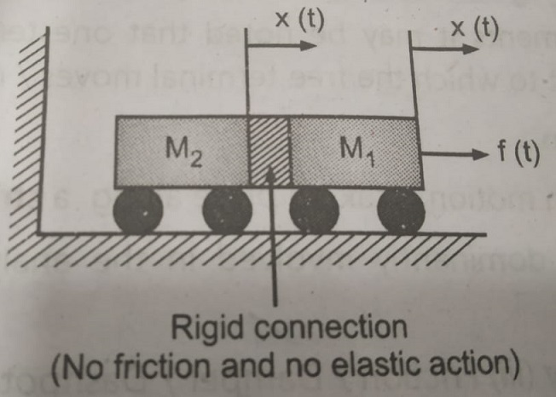
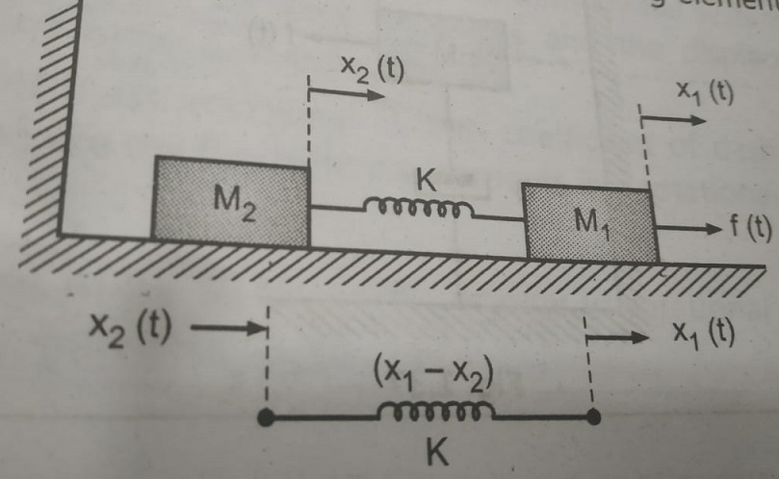
Various Mechanical Systems

Slide 53
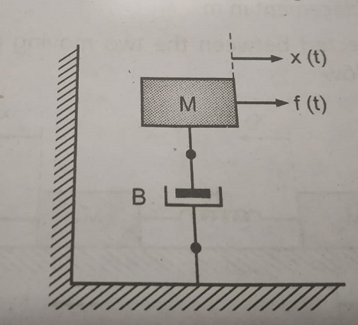
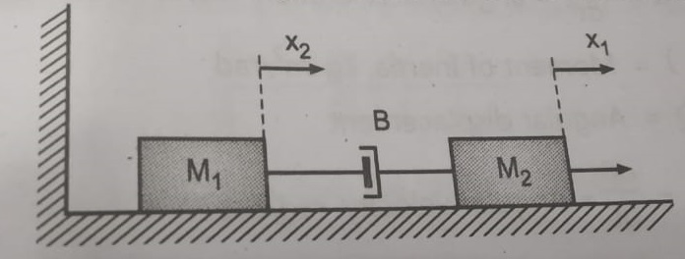
Various Mechanical Systems

Slide 54
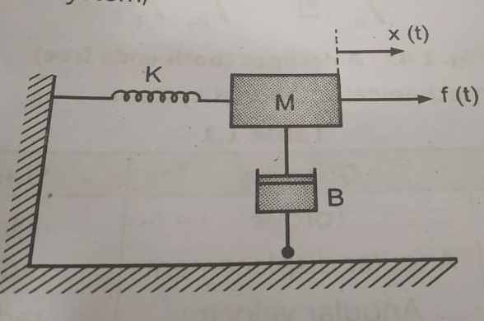
Problems on Mechanical Systems
For the given Mechanical system, Find the Equilibrium conditions (time domain & S-domain equations)

Slide 55
Free Body Diagram
In a free Body Diagram, each mass is isolated from the rest of the system and the forces acting on the mass that cause displacement, forces opposing the displacement are represented pictorially.
Procedure:
Assume the direction of displacement of the mass as positive direction.
Find all the forces with direction acting on mass.
Write Differential equation by equating the sum of opposing forces.
Using Newton’s laws of motion, express all the forces in terms of displacement or velocity of mass.

Slide 56
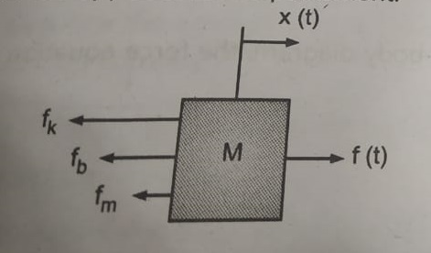
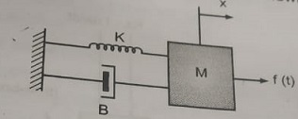
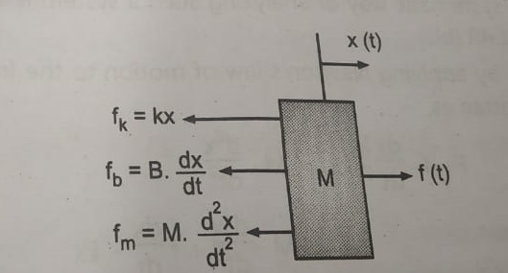
Given Mechanical System
Free body with Forces

Slide 57
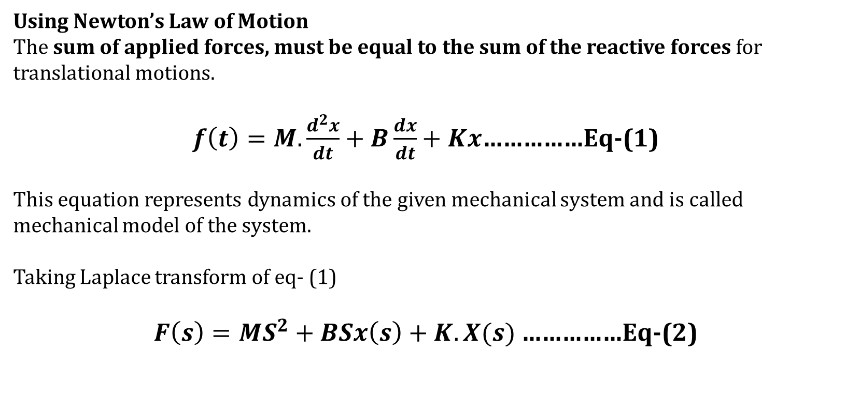

Slide 58
Mathematical Modelling of Control Systems Analogous Systems

Slide 59
Analogous Systems
Systems Can be analogous if;
The two systems are physically different
Differential equation modelling of these two systems are same
There are two types of electrical analogies of translational mechanical systems.
Force voltage analogy.
Force current analogy.

Slide 60
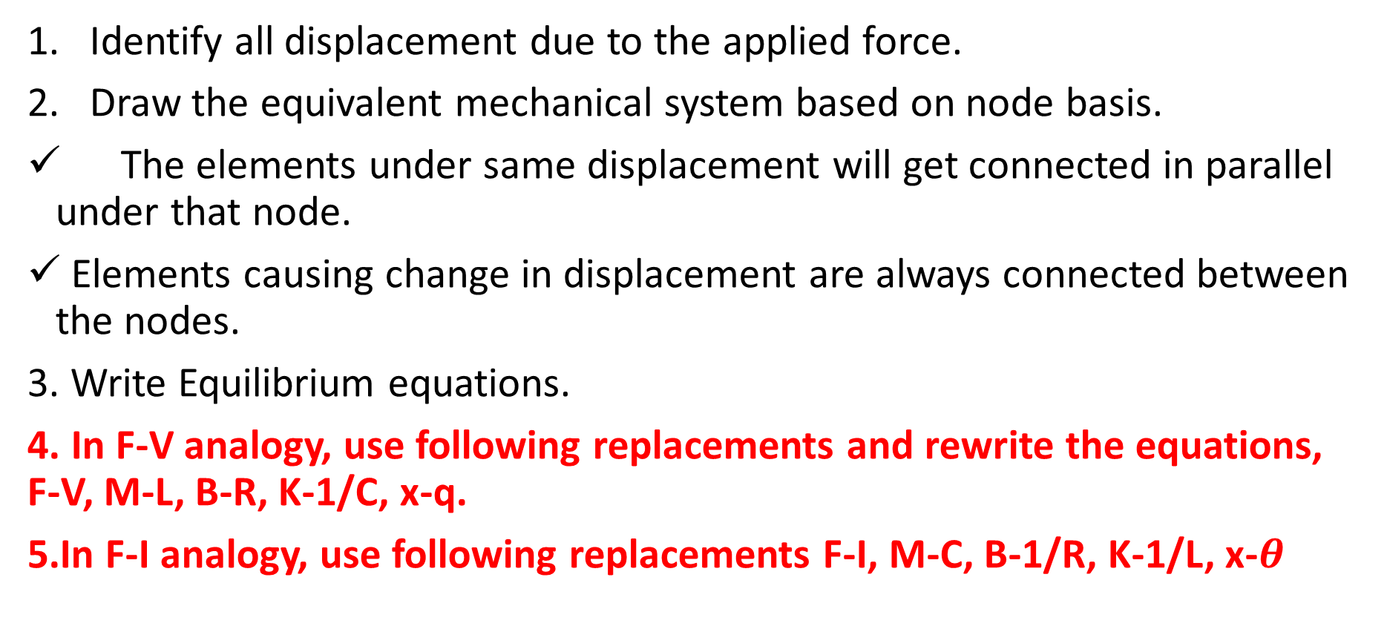
Steps to Solve Analogous Systems Problems

Slide 61




F-V (Loop analysis)

Slide 62
F-V- Analogous Quantities
Translational Mechanical System | Electrical System
Force(F) | Voltage(V)
Mass(M) | Inductance(L)
Frictional Coefficient(B) | Resistance(R)
Spring Constant(K) | Reciprocal of Capacitance (1/c)
Displacement(x) | Charge(q)
Velocity(v) | Current(i)

Slide 63




Force Current Analogy (Node Analysis)

Slide 64
F-I- Analogous Quantities
Translational Mechanical System | Electrical System
Force(F) | Current(i)
Mass(M) | Capacitance(C)
Frictional coefficient(B) | Reciprocal of Resistance(1R)(1R)
Spring constant(K) | Reciprocal of Inductance(1/L)
Displacement(x) | Magnetic Flux(ψ)
Velocity(v) | Voltage(V)

Slide 65
Equivalent Mechanical Systems
To draw such systems from the given mechanical system, follow the steps below
Step 1: Due to applied force, identify the displacements in the mechanical system.
Step 2: Identify the elements which are under the different displacement.
Step 3: Represent each displacement by a separate node, using Nodal Analysis.
Step 4: show all elements in parallel under the respective nodes which are under the influence of respective displacements.
Step 5: Elements causing same change in displacement will get connected in parallel between the respective nodes.

Slide 66


Various Mechanical Systems

Slide 67

Various Mechanical Systems

Slide 68

Various Mechanical Systems

Slide 69

Various Mechanical Systems

Slide 70

Obtain the differential equation of mechanical system. Draw the electrical analogous circuit based on force current analogy

Slide 72
Transfer function of linear systems .
Consider a linear system.
δ (t) -unit impulse input
g(t) – unit impulse response
G(s) = L [g(t)
G(s) - laplace transform of impulse response.
G(s) is the Transfer function of the system.
System
δ (t)
g(t)

Slide 73



input - R(s)
output -C(s)
transfer function

Slide 74
Transfer function of linear time invariant system is defined as,
Laplace transform of impulse response of a system with all initial condition zero.
Also,
It is defined as laplace transform of output to laplace transform of input with all initial condition zero.
transfer function of system = L.T of output/ L.T of input
with zero initial conditions

Slide 75


Laplace equation of mechanical system

Slide 76
Transfer function of mass, spring, and dashpot

Slide 77
Transfer function of basic electrical system

Slide 79


Slide 81


Where, K= is called system gain factor.
Poles of TF: The value of S that makes the TF value infinite is called poles of that system TF.
Zeros of TF: The values of S that makes the transfer function value zero is called zeros of that TF.

Slide 82
Characteristic equation of a transfer function: Equating denominator equation of transfer function to zero is called characteristic equation of that system.
Roots of characteristics equation are poles of TF.

Slide 83
Characteristics of transfer function

Slide 84

Plotting of pole and zero on s plane

Slide 85


Slide 86
Sinusoidal transfer function

Slide 87
Need of Block Diagram Algebra
If the system is simple & has limited parameters then it is easy to analyze such systems using the methods discussed earlier i.e. transfer function, if the system is complicated and also have number of parameters then it is very difficult to analyze it.

Slide 88
Need of Block Diagram Algebra
To overcome this problem block diagram representation method is used.
It is a simple way to represent any practically complicated system. In this each component of the system is represented by a separate block known as functional block.
These blocks are interconnected in a proper sequence.

Slide 89
Basic elements of block diagram
Block
Summing point
Takeoff point .

Slide 90
Block Diagram Fundamentals
Block Diagram: It is shorthand, pictorial representation of the cause and effect relationship between input and output of a physical system.

Slide 91
Block Diagram Fundamentals
Output:
The value of the input is multiplied to the value of block gain to get the output.

Slide 92
Block Diagram Fundamentals
Summing Point:
Two or more signals can be added/subtracted at summing point.

Slide 93
Block Diagram Fundamentals
Take off Point:
The output signal can be applied to two or more points from a take off point.
Z

Slide 97
Block Diagram Fundamentals

Slide 98
Block Diagram Reduction Techniques

Slide 99
Block Diagram Fundamentals
Forward Path:
The direction of flow of signal is from input to output
Feedback Path:
The direction of flow of signal is from output to input

Slide 100
Block in series

Slide 101
Blocks in series

Slide 103
Block in parallel

Slide 104
Associative law for summing pt

Slide 105
Shifting summing point after a block

Slide 106
Shifting take off point before a block

Slide 107
Shifting take off point after a block
= R(s)

Slide 108
Block Diagram Reduction Techniques
While solving block diagram for getting single block equivalent, the said rules need to be applied.
After each simplification a decision needs to be taken. For each decision we suggest preferences as

Slide 109

Transfer function of Control System
Consider transfer function of feedback control system as:
G(S) is called open loop transfer function of closed loop system.
While G(S)H(S) is called open loop transfer function of closed loop system, G(S) is called forward path transfer function and H(S) is called feedback path transfer function.

Slide 112
Where, K= is called system gain factor.
Poles of TF: The value of S that makes the TF value infinite is called poles of that system TF.
Zeros of TF: The values of S that makes the transfer function value zero is called zeros of that TF.

Slide 113
Characteristic equation of a transfer function: Equating denominator equation of transfer function to zero is called characteristic equation of that system.
Roots of characteristics equation are poles of TF.

Slide 114
Block Diagram Reduction Techniques
First Choice
First Preference: Rule 1 (For series)
Second Preference: Rule 2 (For parallel)
Third Preference: Rule 3 (For FB loop)

Slide 115




Slide 116
Block Diagram Reduction Rules
Follow these rules for simplifying (reducing) the block diagram, which is having many blocks, summing points and take-off points.
Rule 1 − Check for the blocks connected in series and simplify.
Rule 2 − Check for the blocks connected in parallel and simplify.
Rule 3 − Check for the blocks connected in feedback loop and simplify.
Rule 4 − If there is difficulty with take-off point while simplifying, shift it towards right.
Rule 5 − If there is difficulty with summing point while simplifying, shift it towards left.
Rule 6 − Repeat the above steps till you get the simplified form, i.e., single block.

Slide 117

Example

Slide 118

Step 1 − Use Rule 1 for blocks G1G1 and G2G2. Use Rule 2 for blocks G3G3 and G4G4.

Slide 119

Step 2 − Use Rule 3 for blocks G1G2G1G2 and H1H1. Use Rule 4 for shifting take-off point after the block G5G5. The modified block diagram is shown in the following figure.

Slide 120

Step 3 − Use Rule 1 for blocks (G3+G4)(G3+G4) and G5G5. The modified block diagram is shown in the following figure.

Slide 121

Step 4 − Use Rule 3 for blocks (G3+G4)G5(G3+G4)G5 and H3H3. The modified block diagram is shown in the following figure.

Slide 122

Step 5 − Use Rule 1 for blocks connected in series. The modified block diagram is shown in the following figure.

Slide 123

Step 6 − Use Rule 3 for blocks connected in feedback loop. The modified block diagram is shown in the following figure. This is the simplified block diagram.

Slide 124
Signal Flow Graph

Slide 125


Slide 127


Slide 128
Different terms used in signal flow graph
Node
Input node
Output node
Mixed node
Branch
Path
Forward path
Forward gain/ forward transmittance
Loop
Forward loop
Forward loop gain
Self loop

Slide 129

Node: x₁ to x₈ are nodes.
Input node or source: x₁
Output node or sink : x₈
Mixed node : x₂ to x₇
Branch :
Transmittance /gain: ‘a’ to ‘j’
Forward path: x₆ – x₇– x₈
Feedback loop: x₂ to x₆ then back to x₂
Self-loop : x₅ having gain f.
Path gain: i*j is path gain for forward path, x₆ to x₈.
Loop gain: loop forming between
x₃and x₄ the gain is c*d.
Non-touching loops: .

Slide 130

Signal flow graph
Signal flow graph is a graphical representation of algebraic equations.
A specialized flow graph, a directed graph in which nodes represent system variables, and branches (edges, arcs, or arrows) represent functional connections between pairs of nodes.

Slide 131
Basic Elements of Signal Flow Graph
Node
A point which represents either a variable or a signal.
There are three types of nodes — input node, output node and mixed node.
Input Node − It is a node, which has only outgoing branches.
Output Node − It is a node, which has only incoming branches.
Mixed Node − It is a node, which has both incoming and outgoing branches.
Branch
Branch is a line segment which joins two nodes. It has both gain and direction.
For example, there are four branches in the above signal flow graph. These branches have gains of a, b, c and -d.

Slide 132
Terms used in linear SFG
Path. A path is a continuous set of branches traversed in the direction indicated by the branch arrows.
Open path. If no node is re-visited, the path is open.
Forward path. A path from an input node (source) to an output node (sink) that does not re-visit any node.
Path gain: The product of the gains of all the branches in the path.

Slide 133
Terms used in linear SFG
Loop. A closed path. (it originates and ends on the same node, and no node is touched more than once).
Loop gain: The product of the gains of all the branches in the loop.
Non-touching loops. Non-touching loops have no common nodes.

Slide 134
The Mason gain formula can be used to obtain the transfer function between input variable R(s) and output variable Y(s) as :
P_{k}= path gain of k-th forward path
∆=1 –(sum of all loop gains of all individual loops) +(sum of the gain products of all combinations of 2 non touching loops) -(sum of the gain products of all combinations of 3 non touching loops)…
∆_{k} = the value of ∆ for the part of the graph not touching the k^{th} forward path

Slide 135


Slide 137



Slide 138


Slide 140

Example
The nodes present in this signal flow graph are y₁, y₂, y₃ and y₄.
Branches have gains of a, b, c and -d.

Slide 141
Terms used in linear SFG
Graph reduction. Removal of one or more nodes from a graph using graph transformations.
Residual node. In any contemplated process of graph reduction, the nodes to be retained in the new graph are called residual nodes.
Splitting a node. Splitting a node corresponds to splitting a node into two half nodes, one being a sink and the other a source.
Index: The index of a graph is the minimum number of nodes which have to be split in order to remove all the loops in a graph.
Index node. The nodes that are split to determine the index of a graph are called index nodes, and in general they are not unique.

Slide 142

Mason’s gain formula
The linear dependence (Gain) T _{i j} between input variable x _{i} and output variable x _{j} is given by the following formula:

Slide 143

An example

Slide 144
Solution
Step 1- Find all forward paths :P1, P2
P₁ = G₁G₂G₃G₄, P₂= G₅G₆G₇G₈
Step 2- Find total number of single loops
L₁=G₂H₂ L₂=G₃H₃ L₃=G₆H₆ L₄=G₇H₇
_{Step 3 - Total} No. of two non touching loops
L₁L_{3 ,} L₁L_{4 ,} L₂L_{3 ,} L₂L₄
Step 4 – There are no 3 non touching loops

Slide 145
_{Step 5- Obtain value of} Δ
Δ= 1 - (L₁+L₂+L₃+L₄)+(L₁L₃+L₁L₄+L₂L₃+L₂L₄)
= 1- (G₂H₂₊G₃H₃ +G₆H₆ +G₇H₇ ₎ ₊ ₍G₂H₂ G₆H₆ + G₂H₂ G₇H₇₊G₃H₃G₆H₆ +G₃H₃ G₇H₇₎
Step 6- Obtain value of Δ1 and Δ2
Cofactor for path 1: (the value of ∆ for the part of the graph not touching the 1st^{h} forward path)
Δ1= 1- (L₃+L₄)
Cofactor for path 2: (the value of ∆ for the part of the graph not touching the 2nd forward path)
Δ2= 1-(L₁+L₂)
T(s) = (P₁Δ₁ + P₂Δ₂)/Δ

Slide 146


Slide 147


Slide 148


Slide 149




Slide 150



Slide 151


Slide 152


Slide 153
Number of forward paths, N = 2.
First forward path is - y1→y2→y3→y4→y5→y6y1→y2→y3→y4→y5→y6.
First forward path gain, p1=abcde
Second forward path is - y1→y2→y3→y5→y6y1→y2→y3→y5→y6.
Second forward path gain, p2=abge
Number of individual loops, L = 5.
Loops are - y2→y3→y2 , y3→y5→y3 y3→y4→y5→y3, y4→y5→y4 and y5→y5

Slide 154
Loop gains are - l1=bjl1=bj, l2=ghl2=gh, l3=cdhl3=cdh, l4=dil4=di and l5=fl5=f.
Number of two non-touching loops = 2.
First non-touching loops pair is - y2→y3→y2, y4→y5→y4
Gain product of first non-touching loops pair, l1l4=bjdi
Second non-touching loops pair is - y2→y3→y2, y5→y5
Gain product of second non-touching loops pair is - l1l5=bjf

Slide 155
Δ=1−(sum of all individual loop gains) +(sum of gain products of all possible two nontouching loops)−(sum of gain products of all possible three nontouching loops)+...
Substitute the values in the above equation,
Δ=1−(bj+gh+cdh+di+f)+(bjdi+bjf)−(0)
⇒Δ=1−(bj+gh+cdh+di+f)+bjdi+bjf

Slide 156

So, Δ1=1
Similarly, Δ2=1

Slide 157

Another example

Slide 158
3 Paths
8 loops

Slide 160
Solution

Slide 162

Find transfer using Mason’s gain formula

Slide 163
Find gain of the system using Mason’s gain formula

Slide 164
Obtain the transfer function Y(s)/ R(s) of the signal flow graph given in Fig. 2 using Mason’s gain formula

Slide 165


Slide 166


